Slide 1
CODE GLADIATOR
Team Members:
1.LOGANATH P
2.GOPISANKAR G

Slide 2
Problem Statement to Debug:
This program is a simple calculator that reads its input from a character buffer. If integers are read, they are pushed on a stack. If one of the operators (+ - * ⁄) is read, the top two elements are popped off the stack, the operation is performed on them,
and the result is pushed on the stack. The = operator writes out the value of the top element of the stack to a buffer.

Slide 3
There was no bug in Header file(Calc.h) and Source file(pushpoh.c)

Slide 4
Main file(calc.c)
Given code:
Debugged code:
sprintf(buf_out,"= %d ",num);
//It doesnot print output value
printf("%d ",num);
//To print the popped number

Slide 5
readtoken.c file
Given code:
Debugged code
Char * buf_in[] ="2 18 + = 5 / =" ;
char buf_in[] ="2 18 + 5 / =" ;
//changed char* to char array
//by removing “= “ before 5 for exact output value 4.

Slide 6
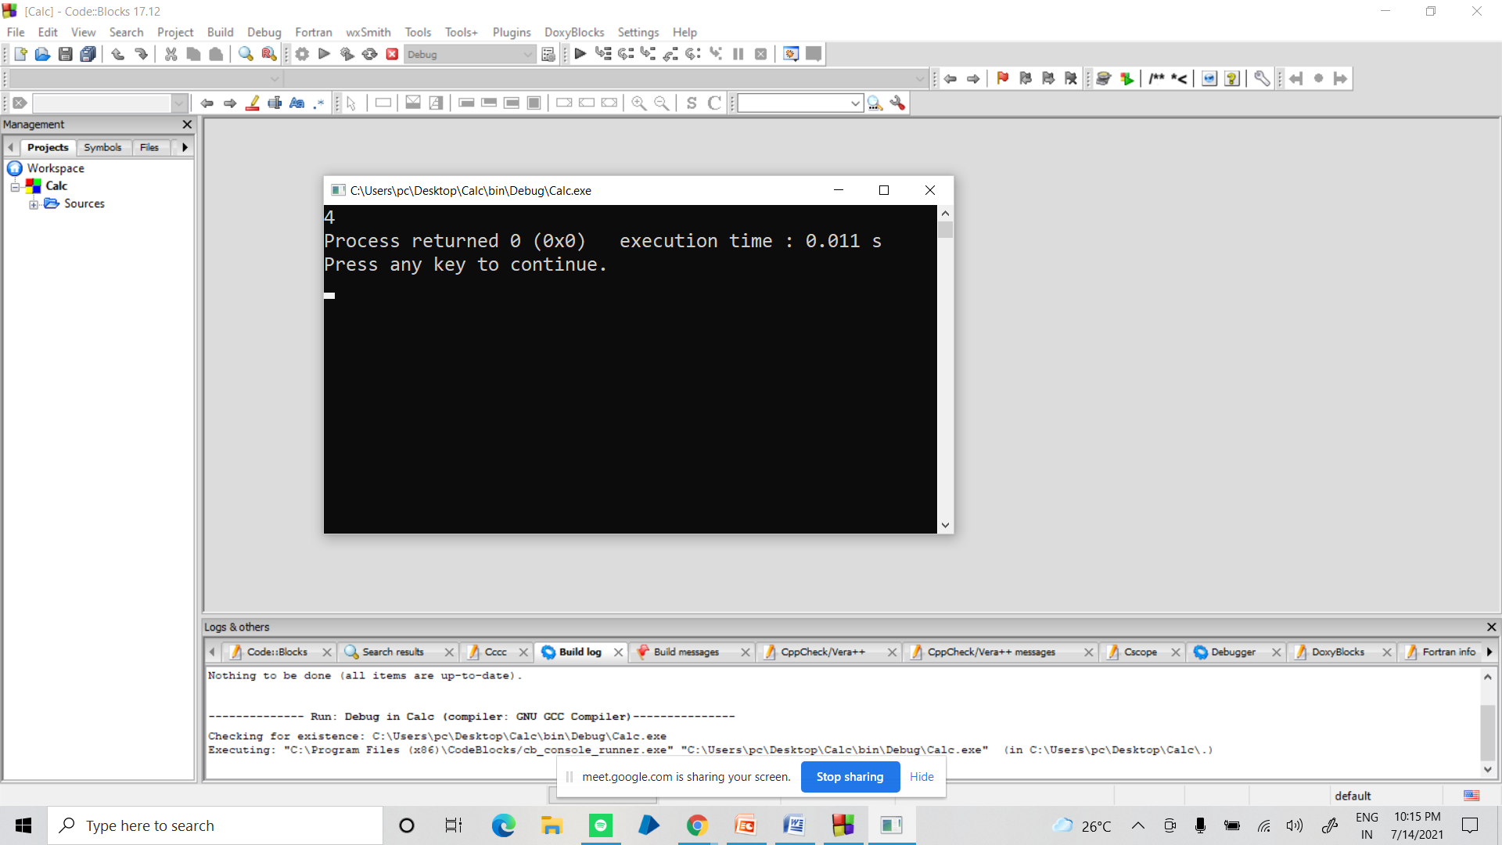
Screenshot:
OUTPUT:

